Slide 1
PRDA – 01 Profit Analysis
Prasad Kshirsagar

Slide 2


AGENDA
INTRODUCTION
Primary goals
Methodology and approach
Results and findings

Slide 3

INTRO
This particular dataset holds data from 50 startups in New York, California, and Florida. The features in this dataset are R&D spending, Administration Spending, Marketing Spending, location features, and Profit.

Slide 4
PRIMARY GOALS
Perform Regression Analysis for the given data to identify how the money spent on Marketing, R&D, and Administration is affecting the company’s Profit.
Visualize the data and find insights

Slide 5
Methodology and approach
To get data from the database with given credentials we use MY-SQL.
After that we have used Excel for regression analysis.
Visualization was done in Power Bi and Excel.

Slide 6
Result and findings
We have used predictive analysis to find relationship between R&D ,Administration, Marketing Spend with Profit.
Have predicted profit if spendings on R&D ,Administration , Marketing is known.
Visualization of data was also done.

Slide 7
RESULT AND FINDINGS
Prediction of Profit
Y=m1x1+m2x2+m3x3+C
R&D Spend | Administration | Marketing Spend | Profit
21892.92 | 81910.77 | 164270.7 | 70037.9
23940.93 | 96489.63 | 137001.1 | 70554.57

Slide 8
DATA VISUALIZATION

Slide 9
DATA VISUALISATION

Slide 10
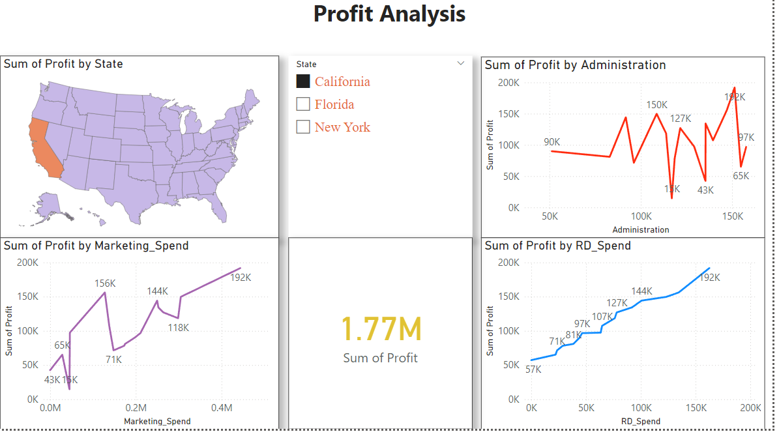
DATA Visualisation

Slide 11
INSIGHTS
There is no direct relationship between Administration Spend and Profit while is some relationship between Marketing Spend and Profit.
It is clear that there is direct relationship between R&D Spend and Profit. As the R&D Spending Increases Profit Also Increases.
Startup companies in New York and Florida has recorded slightly more Profit than startup companies in California.

Slide 12
Recommendations
The Companies Should Increase R&D Spending to Increase their Profit.
The companies can also Increase Marketing Spend as there is some relationship between Marketing Spend and Profit.

Slide 13
THANK YOU

